Slide 1
Towards Advancing T20 Cricket
August 18th, 2022
MSc. Applied Data Science
The University of The West Indies, Mona
Prepared By: Simon Lee | Student Data Scientist

Slide 2
Background
Here’s some brief, but helpful information
Cricket is a sport dated to have started in the late 16th century with matches traditionally lasting up to 5 days.
Simply put, the objective of cricket is to accumulate more runs than the opposing team (teams comprised of 11 players each).
With time, the sport has evolved into new, shorter and more exciting formats, ODI Cricket and most recently, T20 Cricket (2005) which last 8 hours and 4 hours respectively.

Slide 3
TABLE OF CONTENTS
02
Introduction
02
Questions
02
Public Sentiment
02
Demonstration of Team Selector
02
Team Selector
02
Next Steps & Conclusion
01
04
Intro and Goals
02
05
Twitter Sentiment Analysis
Video Demonstration
03
06
Match data To build Model

Slide 4
INTRODUCTION
INTRODUCTION
INTRODUCTION
INTRODUCTION
INTRODUCTION
T20 Cricket has grown to be the most played format
Imperative to maintain fan support
T20 matches are typically more unpredictable and do not allow tactical substitutes in match
Add competitive advantage through team selection by the use of decision making tool

Slide 5
GOALS
GOAL 1
GOAL 2
GOAL 3
Get a general understanding on the public perception of T20 Cricket and how it has changed over time (if any)
Create a Decision Making Tool to automate selection of a T20 Cricket Team
Produce a database of players with statistics and player information

Slide 6
PUBLIC
SENTIMENTS

Slide 7
PUBLIC SENTIMENTS
DATA COLLECTION
DATA PROCESSING
DATA PREPARATION
VISUALIZATION
Tweets were passed through TextBlob and the Polarity was collected
Tweets about T20 Cricket from 2007 collected from Twitter
Polarity > 0.2 –> Positive
Polarity < -0.2 –> Negative
Removed any symbols from tweets to have just the text remaining
Graphed how the percentage of negative and positive tweets per year have changed over time

Slide 8
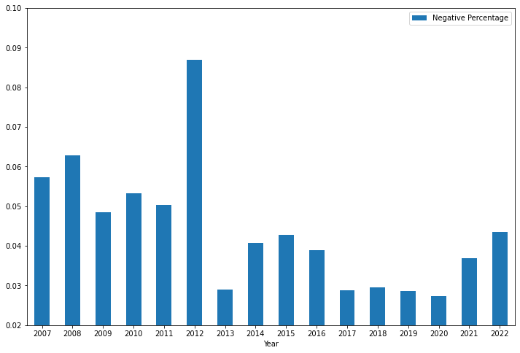
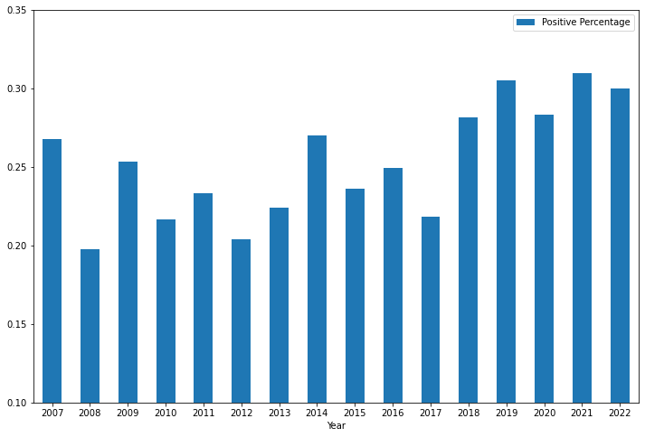
INTRODUCTION
RESULTS
PERCENTAGE NEGATIVE TWEETS
PERCENTAGE POSITIVE TWEETS
The general public has become more enthusiastic about T20 Cricket

Slide 9
TEAM
SELECTOR

Slide 10
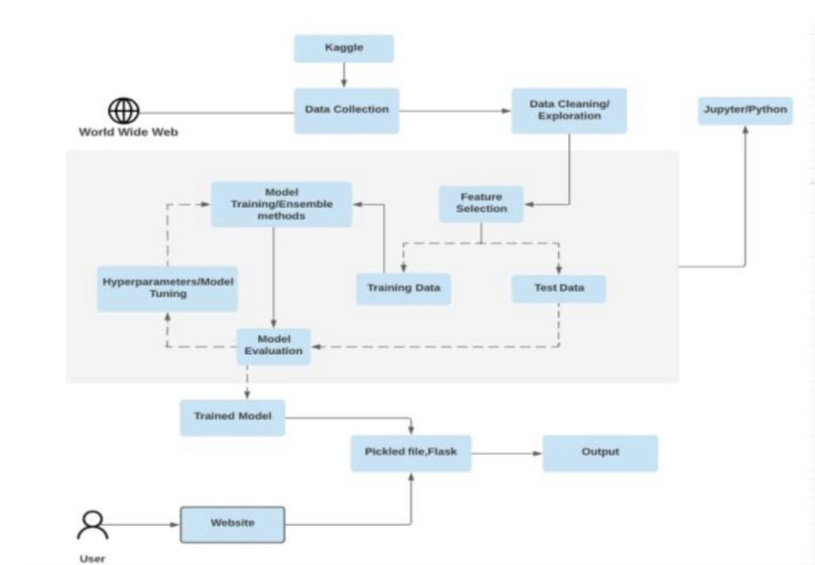
PROCESS FLOW
Cricsheet
Data Collection
Data Cleaning and Exploration
Jupyter/Python
World Wide Web
Training Models/Ensemble Models
Feature Selection
Hyperparameters / Model Tuning
Training Data
Test Data
Evaluation
Trained Model
Saved Model
Recommended Team (Output)
User Interface
User

Slide 11
DATA COLLECTION
CRICSHEET
CricInfo
Match Data in csv files
Player sheet with IDs of players
Web scraped CricInfo for player batting style, bowling styles, player roles and general information

Slide 12
DATA PREPARATION/CLEANING
Player Name Inconsistencies
Missing Player Roles
Categorize Bowling Types
Generate Team Compositions
A function was created and applied to fix naming errors from match data using IDs
Used player usage from Data to generate player roles
Categorized Bowlers by which arm they used to bowl as well as whether they are a fast bowler, wrist spinner or regular spinner
For each match get the number of each type of player that represented each team

Slide 13
DATA PREPARATION/CLEANING (CONT.)
Generate Player Stats
Player Averages
Categorizing Location of Match
When a player has yet to be dismissed, average made to be total runs made
Batting Average, Strike Rates, Bowling Economy, Bowling Average etc.
Categorizing and Label Encoding of Country/Region of match

Slide 14
MODEL CREATION - TO PREDICT WIN
Feature Selection
Splitting Train and Test Data
Training of Model
Evaluation
Using team composition and location of match
Data was split in ratio 80:20. This split was stratified to ensure even representation of outcomes
Using grid search, data transformers and classifying algorithms
Test how well model performed against test data

Slide 15
TRAINING OF MODEL
Grid Search
Power Transformer
ExtraTreesClassifier
To find optimal combination of parameters to produce “best” model from parameter options provided
Uses a combination of decision trees on small sub-samples of dataset to improve accuracy and control over-fitting
To reduce any skewness seen in data

Slide 16
EVALUATION OF MODEL
57% - 72%
61%
ACCURACY OF PREVIOUS WORK DONE
ACCURACY
59%
66%
Predicting “Home” Win
Predicting “Away” Win
Model predicted match outcome correctly
Based on research done on 50 Over Cricket
Slightly less than overall model
More than overall model

Slide 17
MODEL DEPLOYMENT
Input Pool Of Players to Select From
Input Expected Playing 11 of Opponent
Select the Country/Region Match is being Played
Find All Possible Combinations of Teams
Pass Each Combination Through Model
This represents the available squad the coach/captain can choose from
The 11 Players you expect the opposition to pick
Location of match
All legitimate team compositions from our selection pool will be found
Each Combination of team found along with the composition of the expected team will be passed through the model
Note: Team must have at least 4 batters, and at least 5 players that bowl and 1 wicketkeeper

Slide 18
MODEL DEPLOYMENT - SELECTION
Store Composition that Gives Highest Chance of Winning
Fill in Players That Result in Highest Batting Index
This composition is what will be filled out with available players
Using player statistics, the recommended playing 11 is filled in based on the team with best stats

Slide 19
QUESTIONS?

Slide 20
TEAM SELECTOR
DEMO

Slide 21

DEMO OF INTERFACE

Slide 22
NEXT STEPS (Possible Improvements)
STEP 1
STEP 2
Improve Interface once tool is used more often
Possibility of using recent player performances in selection (Player Form)

Slide 23
Conclusion
GOAL 1
GOAL 2
GOAL 3
General public has been more positive and less negative about T20 Cricket over time
Team Selector was created given pool of players to select from, opposition and location
Database created and would be provided to users of this tool

Slide 24
THANKS
FOR LISTENING

